Slide 1

Social Media Analysis on Target(retail) Black Friday data - 2k18
By
Siva Kiran, Thatikonda
Venkat Phani Saroj Bodepudi

Slide 2
Work Flow
Data extraction
Exploratory data analysis (EDA)
Sentiment Analysis
Visualization
Word Cloud
Topic Modeling

Slide 3
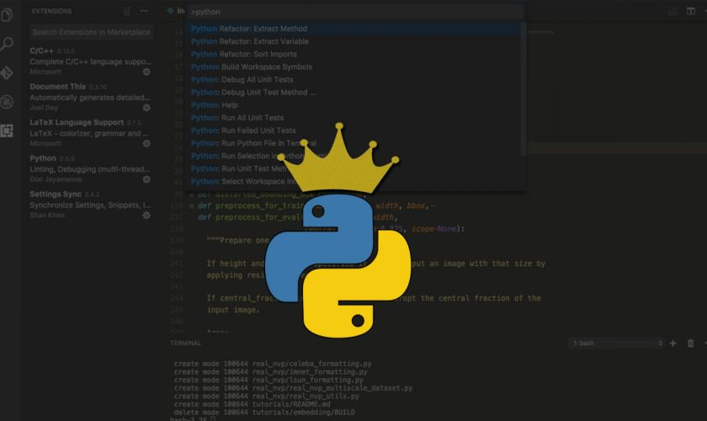

Languages and Tools
Data Extraction (python)
Exploratory data analysis (python)
Sentiment Analysis (python)
Visualization (power bi )
Word Cloud (python)
Topic Modeling (python)

Slide 4
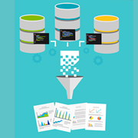
Data Extraction
How we extracted data ?
Filter word (#Target)
Time frame
In which format we stored data?

Slide 5

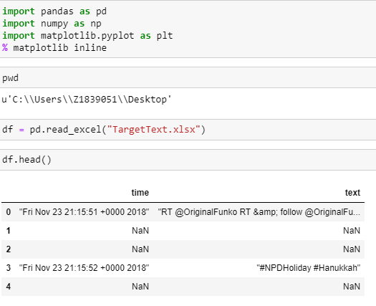
Exploratory data analysis (EDA)
Pandas

Slide 6
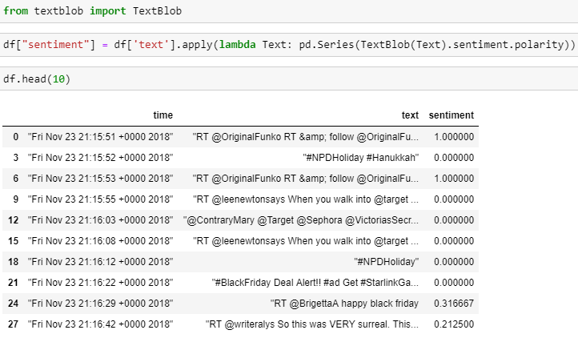
Sentiment Analysis
Text Blob
Created a new column named sentiment in our data frame.

Slide 7
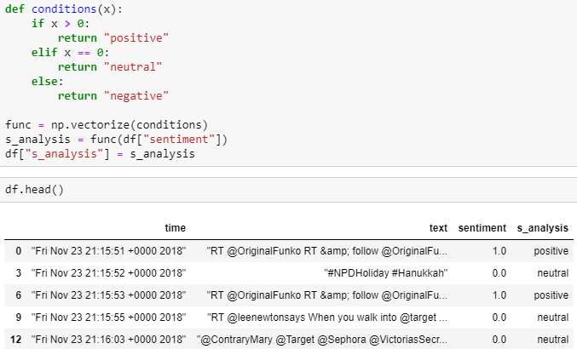
Analysis
Created another column named s_analysis.

Slide 8
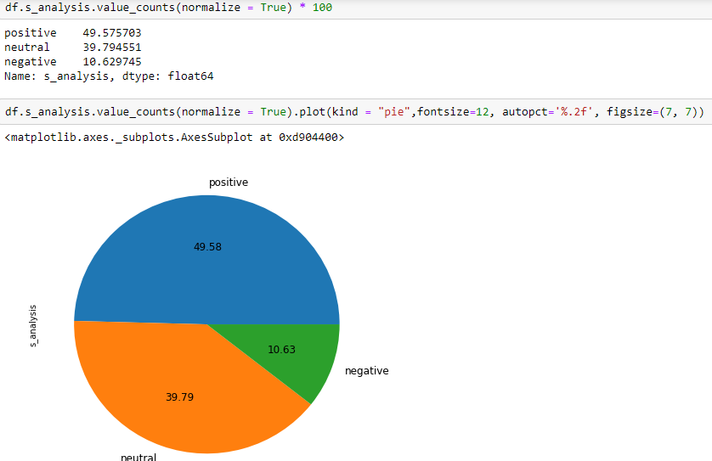
Data Visualization
Visualization of Segmented s_analysis column

Slide 9
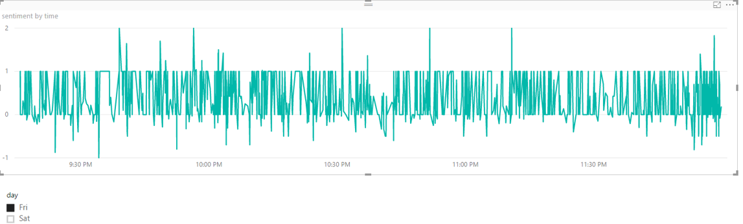
Data Visualization
Power Bi ( Sentiment analysis on tweets corresponding with time)

Slide 10
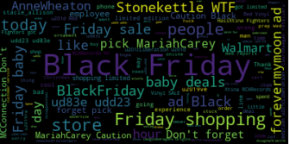
Word Cloud on negative tweets
WordCloud library

Slide 11
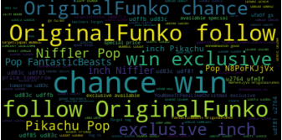
Word Cloud on positive Tweets
WordCloud library

Slide 12
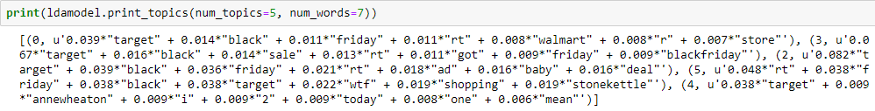
Topic Modeling on negative tweets
Gensim library
Nltk library
Model used: LDA

Slide 13
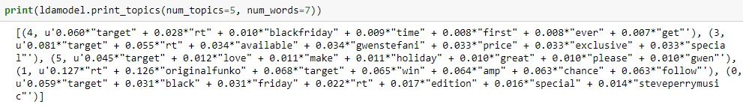
Topic Modeling on Positive tweets

Slide 14


